Slide 1
Test Standardization : Relay Matrix

Slide 2
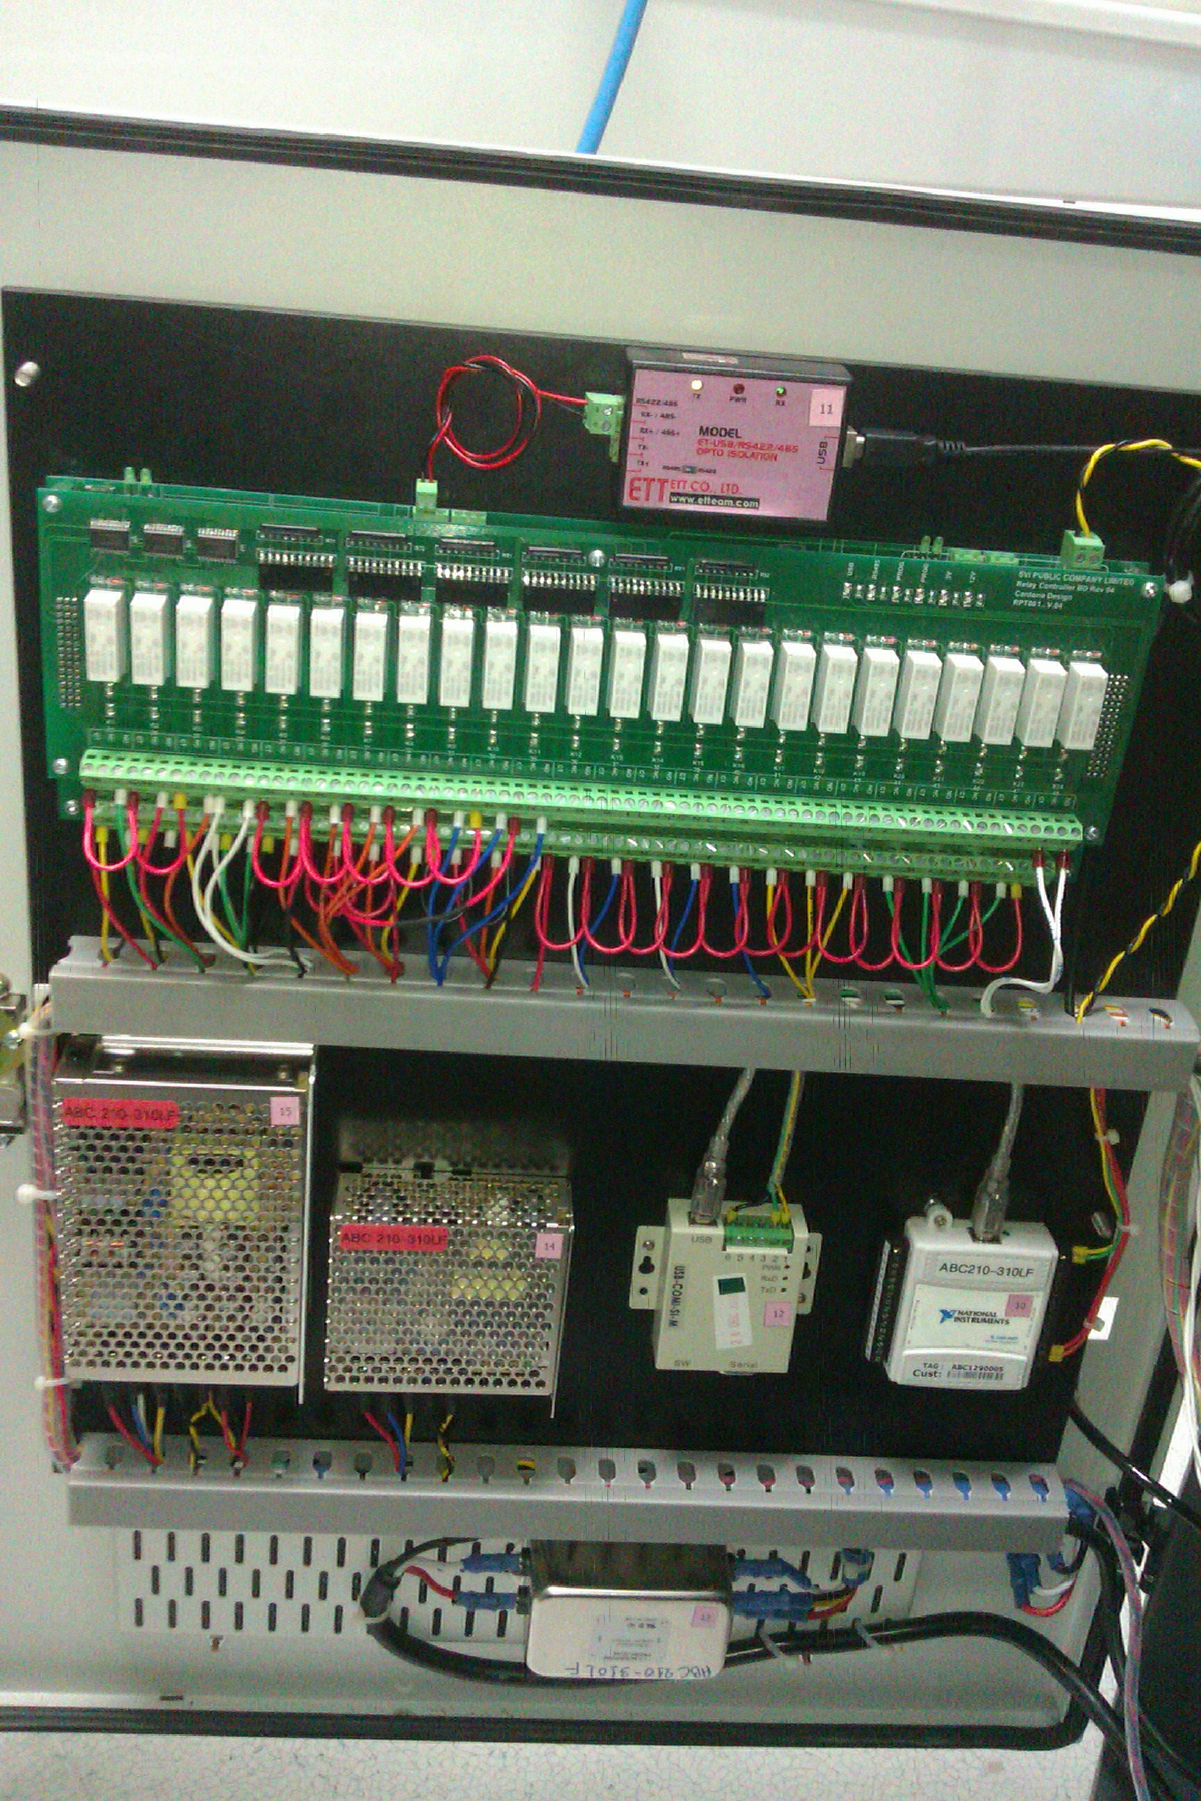
Design Pattern
RS488
Obsolete Components
All Power Relays
IO

Slide 3
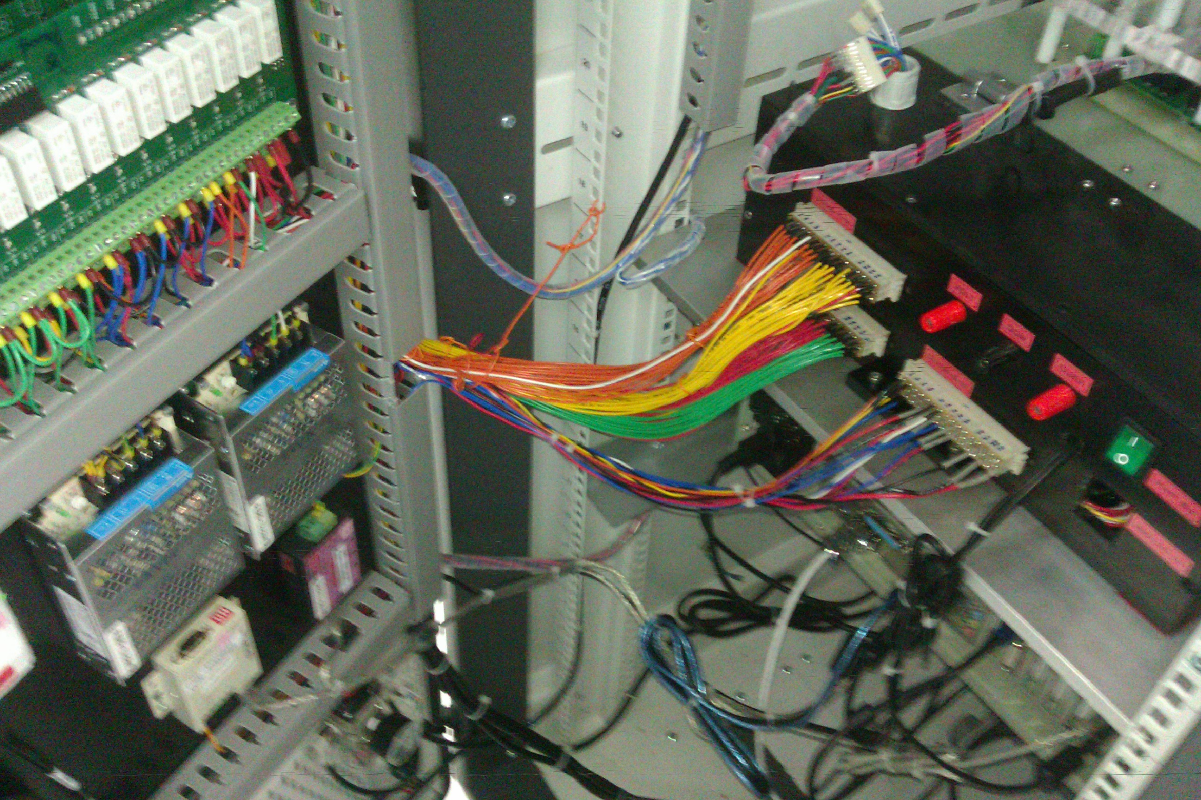
Design Pattern
Long cables
Many connections
(time consuming implementation)
Pinch

Slide 4
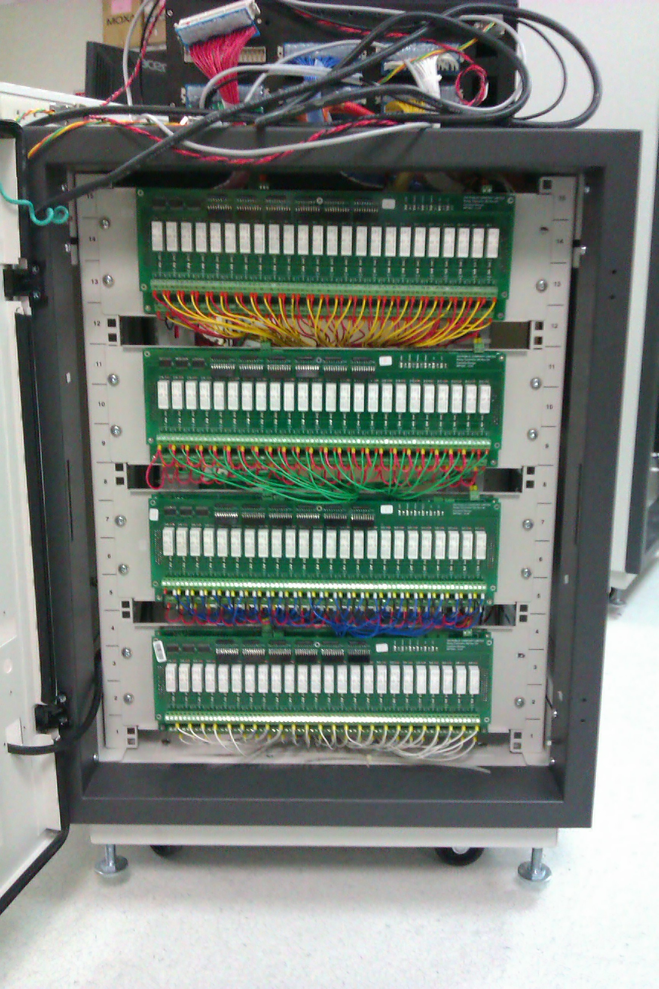
Design Pattern
Long cables

Slide 5
Standardization Goals
• Short cables
• Less connectors
• Faster implementation
• Faster running test program
• More comfortable debugging
• Modular approach
• Capable to handle bigger projects
• Relay life time monitoring
• Build in traceability (Matrix + JIG)
• Minimal software development
• Direct use of IO’s (sensors & actuators @ 24/5V)
• Dedicated emergency brake
• Small enough to house the Matrix IN the JIG-Box
• Able to determine price & implementation time while quoting

Slide 6
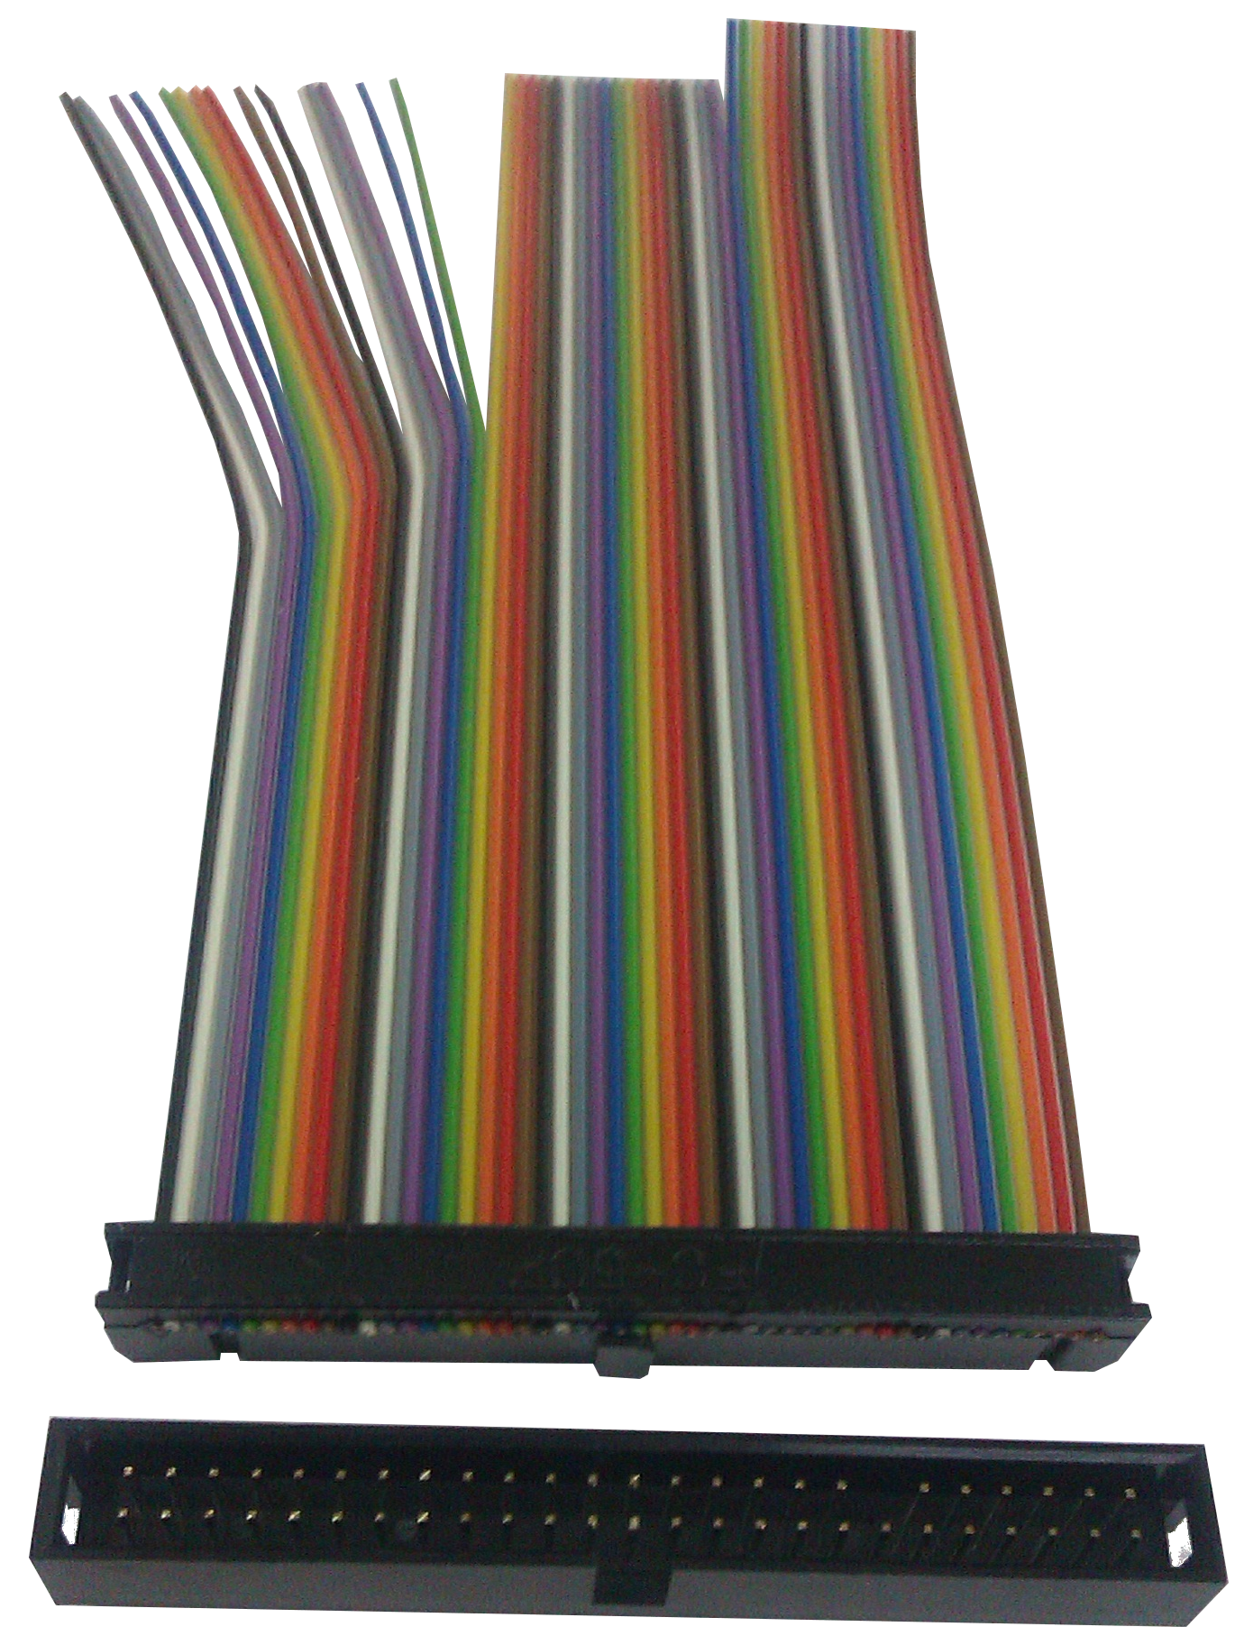
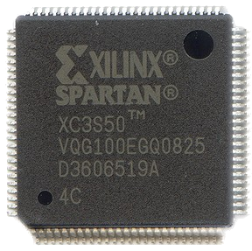
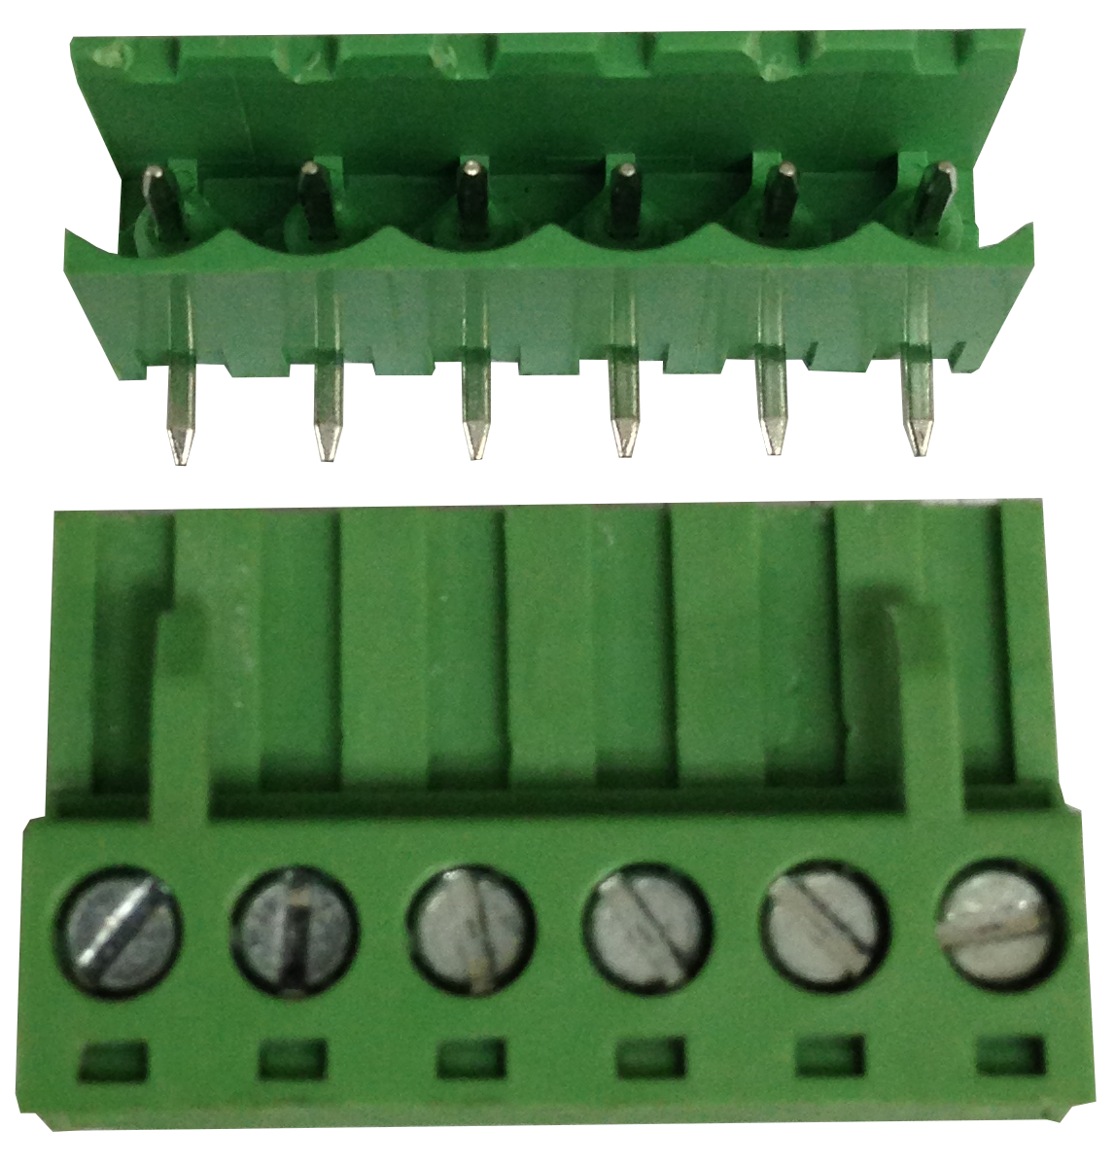
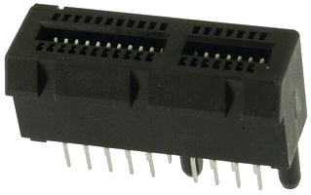

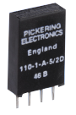
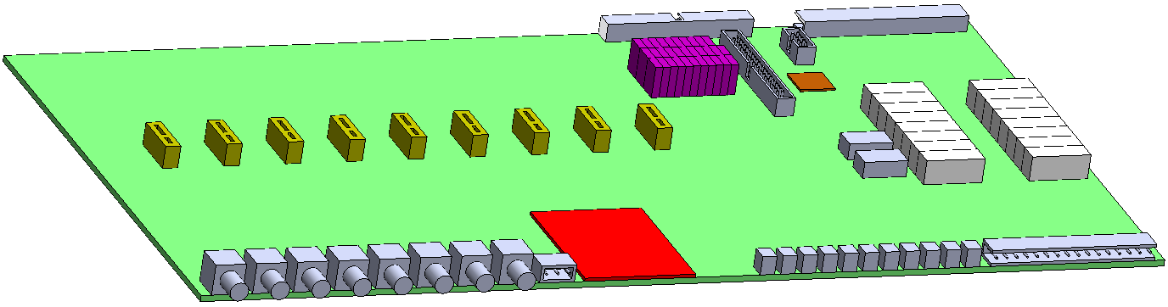
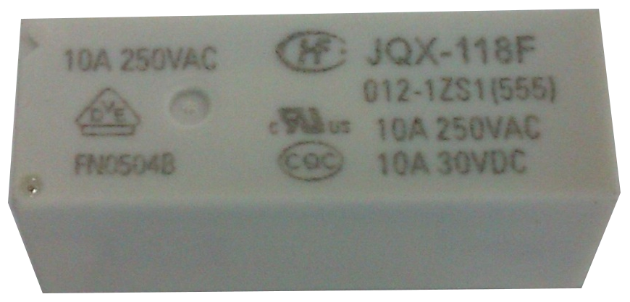
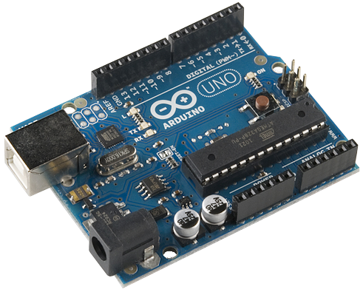
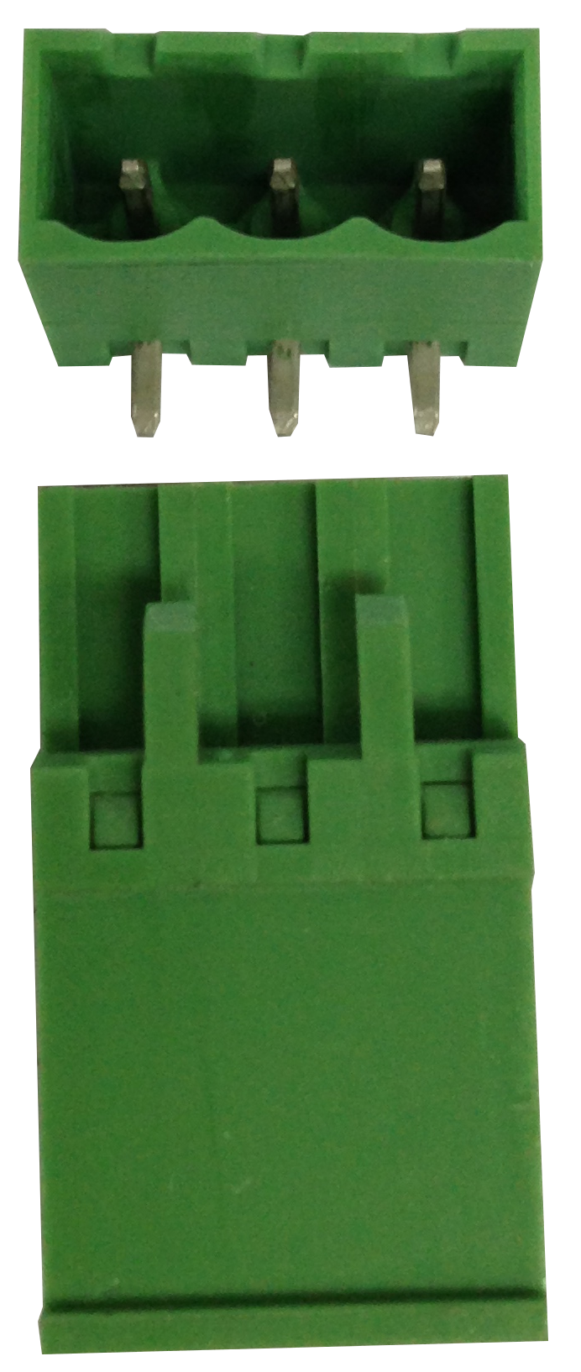
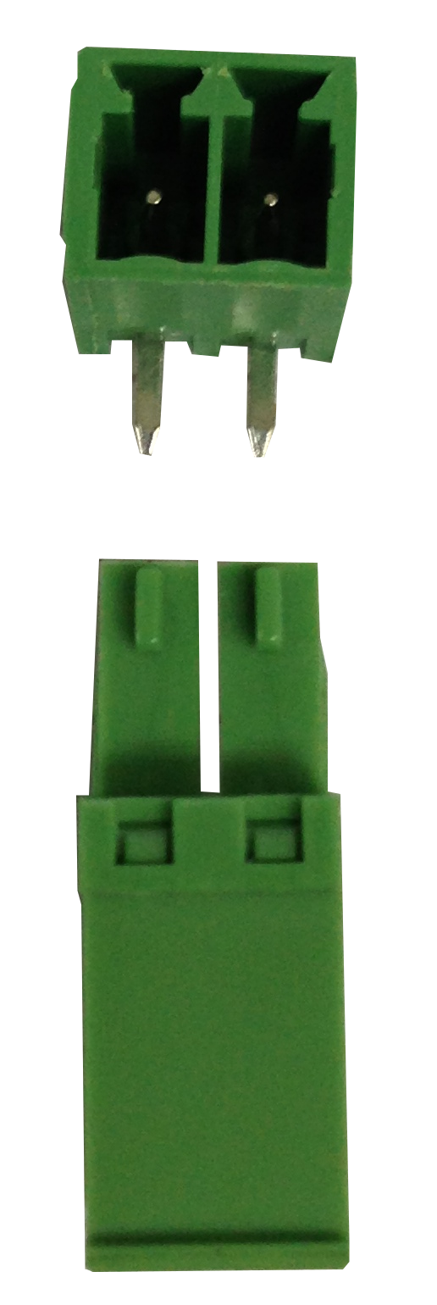
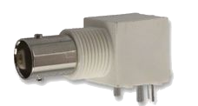
Mother Board
FPGA
32
Signal
Relays
Relay Extension Slots
To JIG
16
Power
Relays
. . . . . . .
CPU
Board
Power
To Sources
USB To PC
6 Input & 5 Output
To Measurement Resources

Slide 7
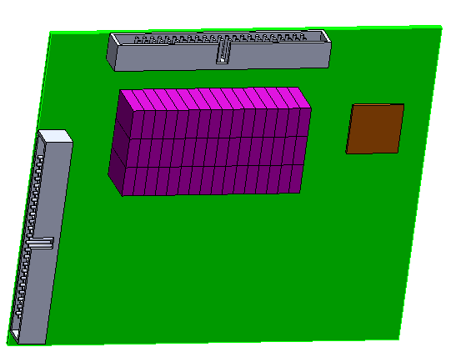

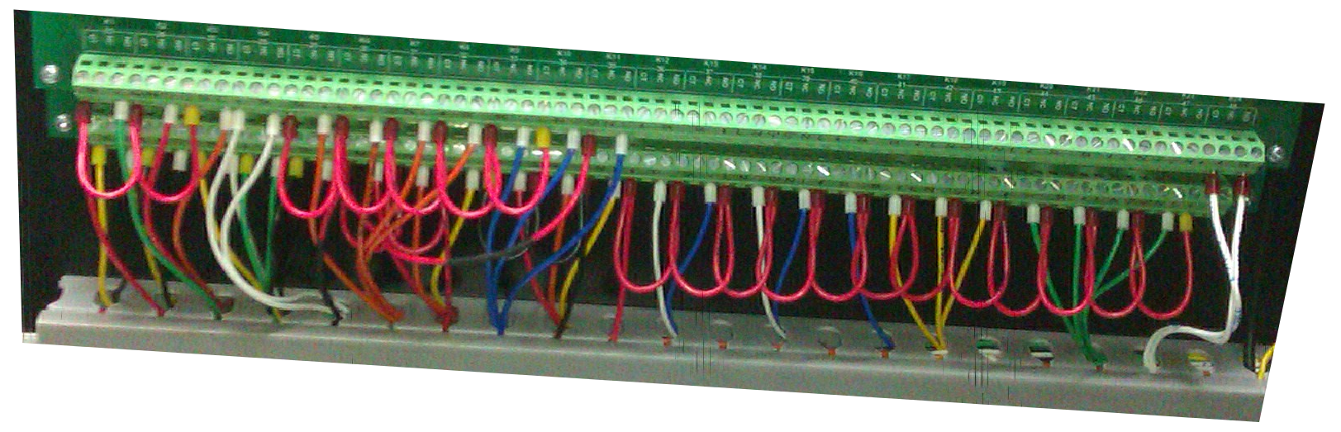
To JIG
Debug
Board
Configuration Area

Slide 8
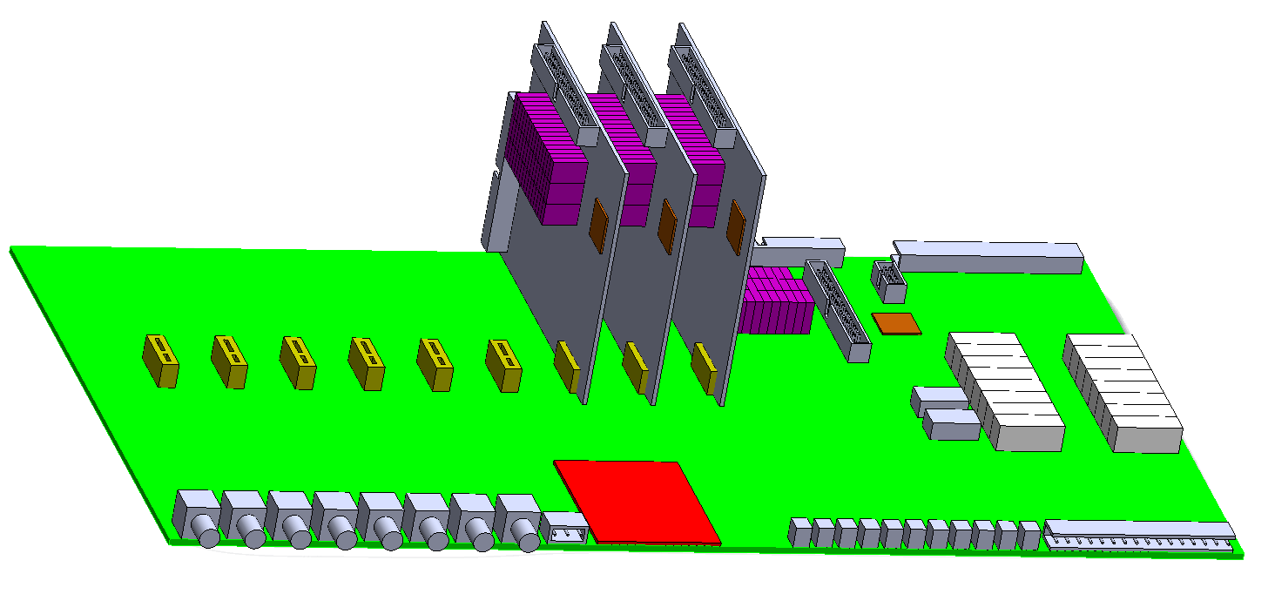
4 x 48 = 192 POGO’s
11 Cm
25 Cm
47 Cm

Slide 9
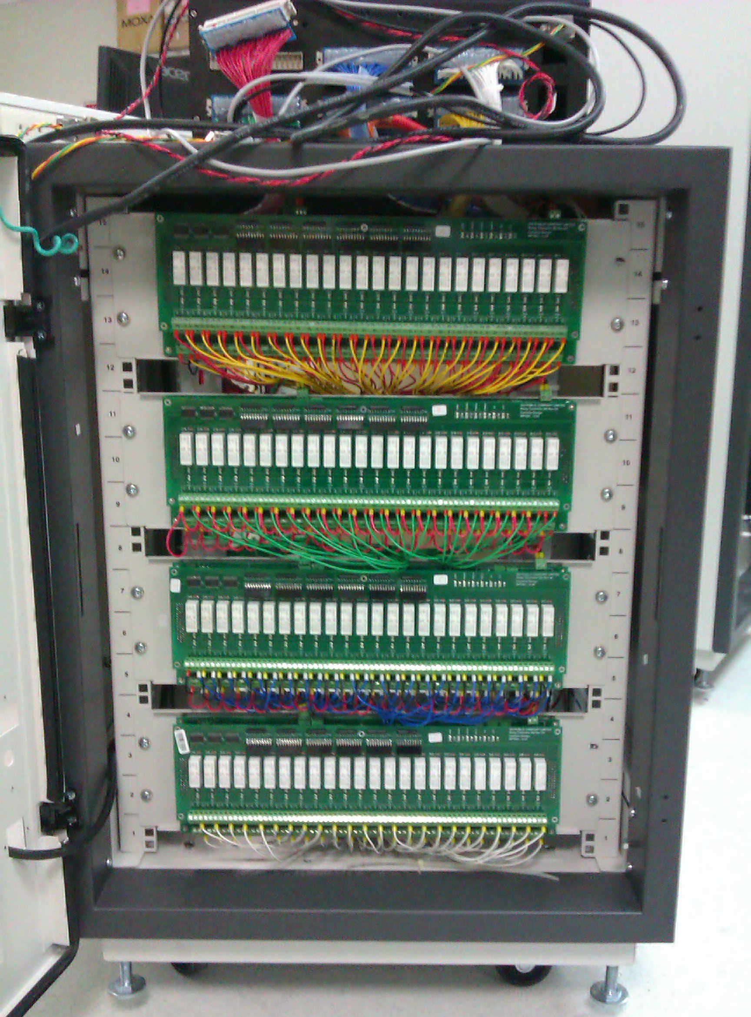
4 x 48 = 192 POGO’s

Slide 10
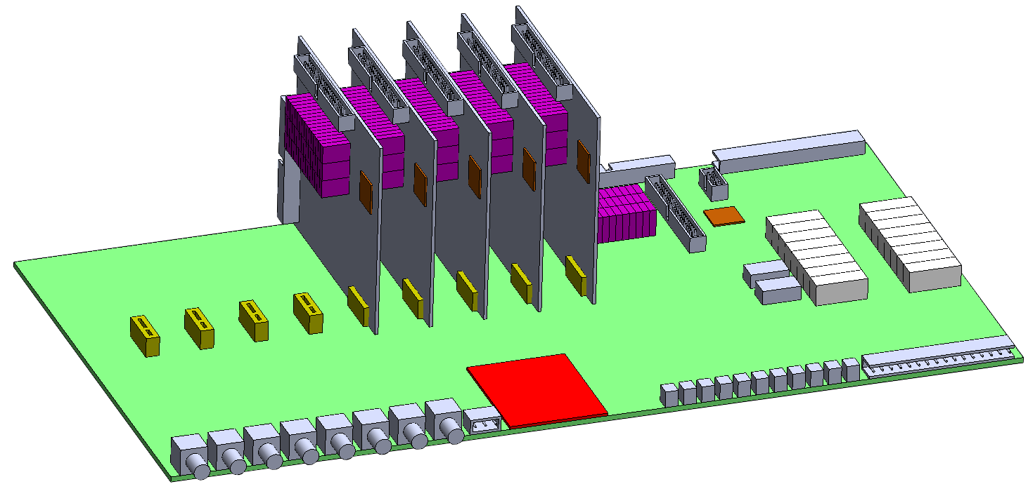
6 x 48 = 288 POGO’s

Slide 11
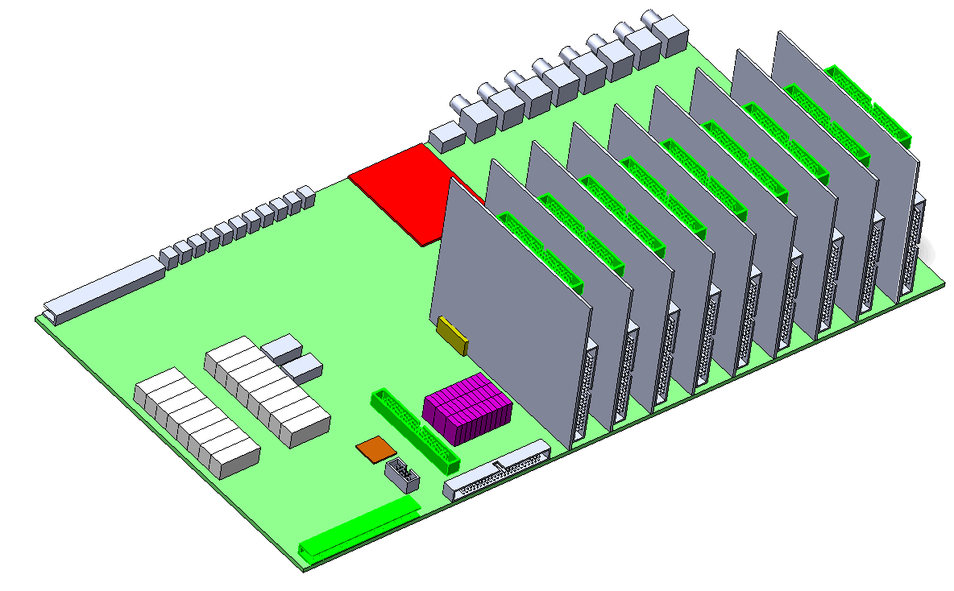

Slide 12
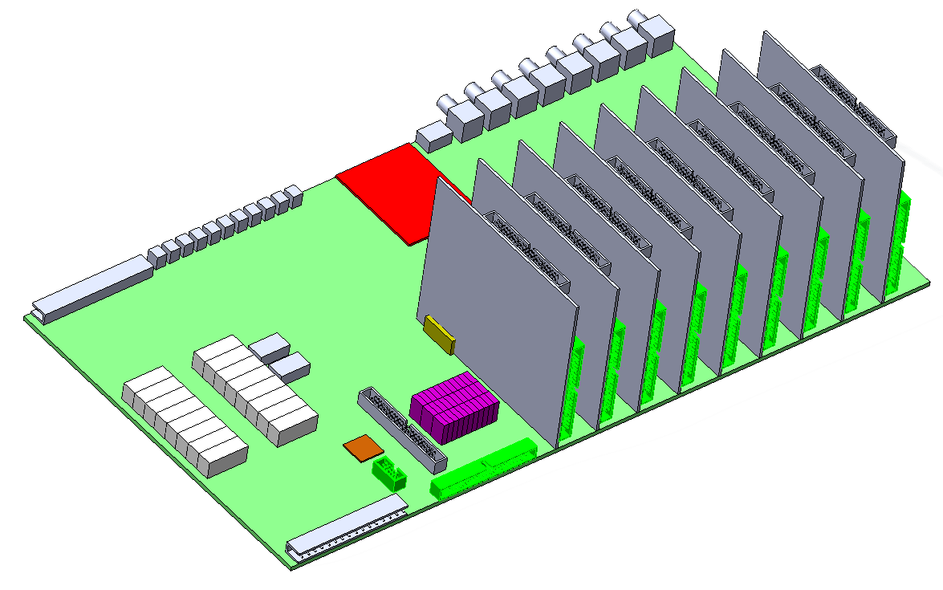

Slide 13
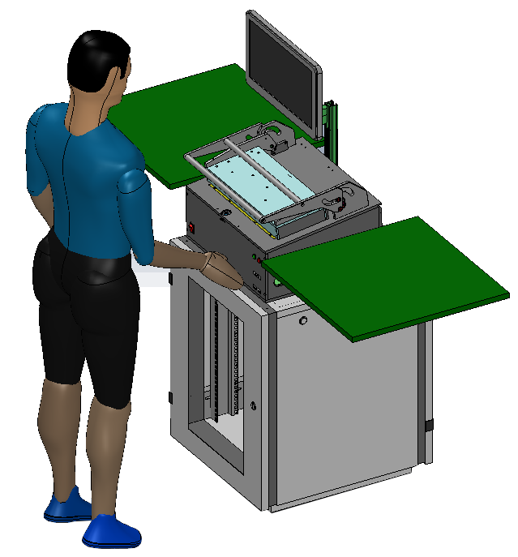

Slide 14
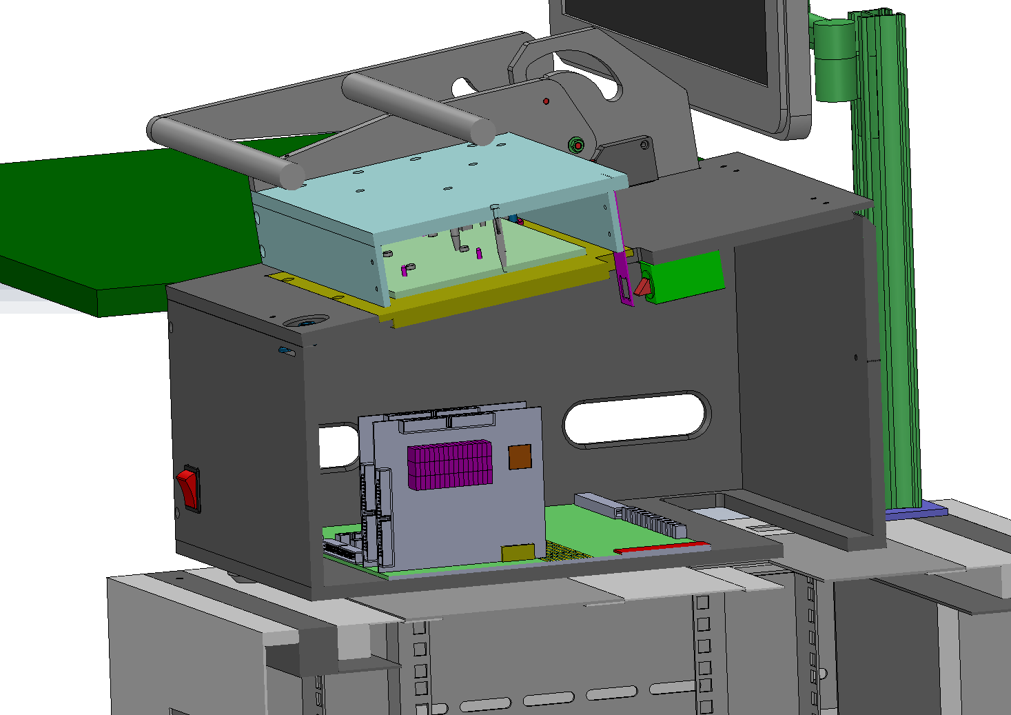

Slide 15
Questions ?

